Slide 1
Federal Reserve System - Roles
Federal Reserve
Monetary Policy
Supervision and Regulation
Dual Mandate:
1 Maximum Employment
2 Price Stability
and:
Stability of Financial System
Conventional Monetary Policy Tools
Unconventional/Emergency Monetary Policy Actions
Short term interest rates
Reserve requirements
Asset purchases
Lending facilities

Slide 2
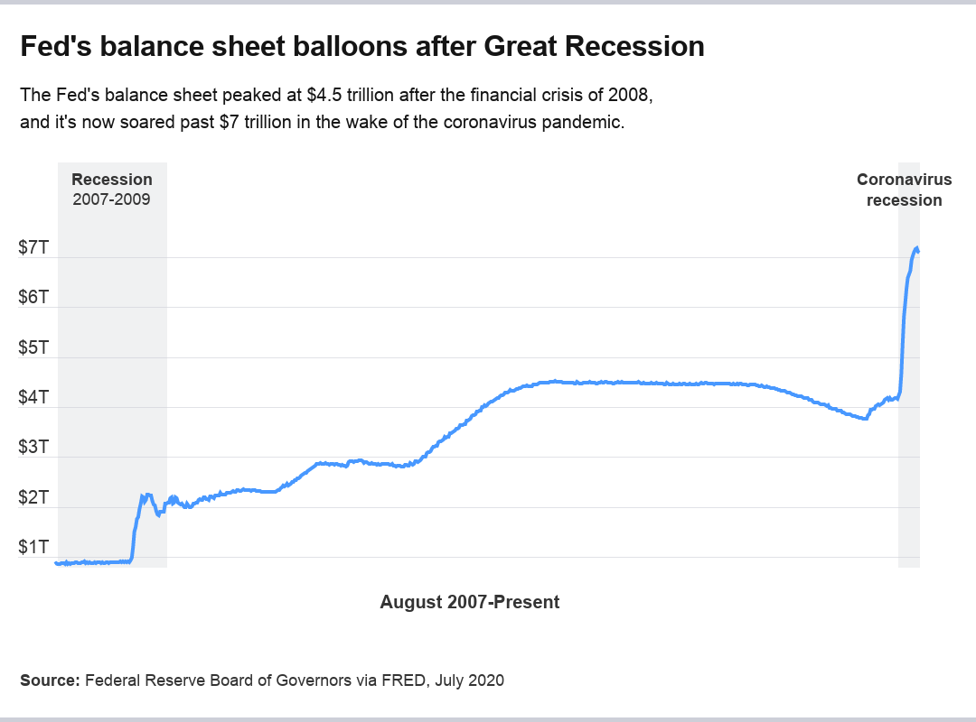
Federal Reserve’s Balance Sheet https://www.bankrate.com/banking/federal-reserve/federal-reserve-balance-sheet/
In November 2008, then-Fed Chairman Ben Bernanke faced a financial panic. The Fed reduced interest rates to virtually zero, but that still wasn’t enough to jump start an economy suffering its worst turmoil since the Great Depression.
To inject more life into the financial system, the Fed turned to unconventional and unprecedented measures: It started buying long-term Treasurys, federal agency debt and mortgage-backed securities to “increase the availability of credit” for home purchases and prop up the economy, according to a Fed statement from 2008. That was also supposed to lower interest rates even more, providing more stimulus to the economy and incentivizing more borrowing and lending.

Slide 3
Federal Reserve Actions

Slide 4
Federal Reserve’s Balance Sheet https://www.federalreserve.gov/monetarypolicy/2020-06-mpr-part2.htm
The Size of the Federal Reserve's Balance Sheet Has Increased Considerably
In response to the financial and economic disruptions caused by the COVID-19 pandemic, the Federal Reserve has eased the stance of monetary policy and has deployed various tools to promote smooth functioning of financial markets and the flow of credit to households and businesses.
To support the smooth functioning of those credit markets that are critical for the economy, the Federal Reserve:
purchased Treasury securities and
agency residential and commercial mortgage-backed securities (MBS and CMBS),
expanded repurchase agreement (repo) operations, and
introduced several credit and liquidity facilities.
As a result of these actions, the size of the Federal Reserve's balance sheet increased from $4.2 trillion at the beginning of 2020, approximately 19 percent of U.S. nominal gross domestic product (GDP), to $7.2 trillion in June 2020, approximately 33 percent of U.S. nominal GDP.
.

